Slide 1
ESE 3002 PROJECT PREPARATION Chandra Shekar Reddy Saga(c0747253)
(Internet Of Things device)
Smart door bell camera
(human solution)

Slide 2
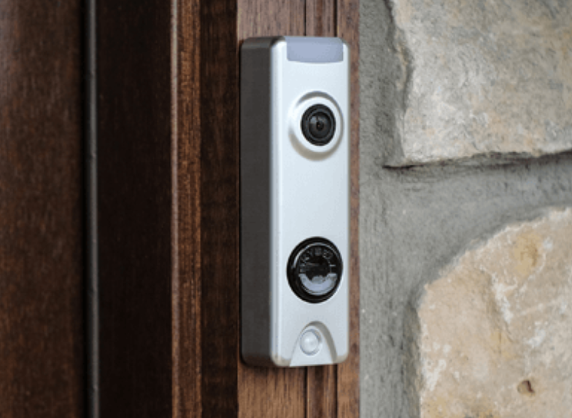
Wireless Doorbell camera.

Slide 3
Introduction
Internet of Things (IoT) :Works with internet, artificial intelligence technology like computers.
Remoted operation.
Works on 5G network.

Slide 4
Block diagram
Image sensing
Video acquisition
Application specific information processing
display

Slide 5
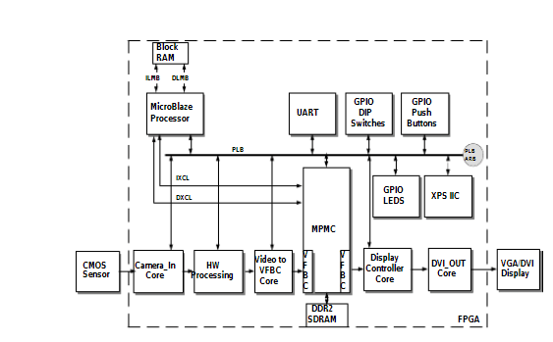
Architecture of smart camera (FPGA)

Slide 6
human solution
The end user is the owner of the home, company, store etc..,
Safety and security is the primary concern.
Smart room bell will prevent from unnecessary hassles.

Slide 7

Necessary modifications
Identifying the person and giving free access.
Image detecting sensor can be used.
(AMI) 1-kilobit DRAM chip used as an image sensor.

Slide 8
Advantages:
1.Free access to the person already known by you.
2.No interruption while you are busy.
Disadvantages:
1.Memory is an cost effective factor.
2.24*7 internet.

Slide 9
Conclusion
New technologies can overcome the disadvantages and better security can be availed by the end user.
We can get compact security systems so that we can carry anywhere.

Slide 10


Slide 11
References:
1. https://hal.archives-ouvertes.fr/hal-01571292/document

